Slide 1
To Inspections and Beyond: The Latest From OSHA January 6, 2025
Presented by:
Phillip B. Russell

Slide 2
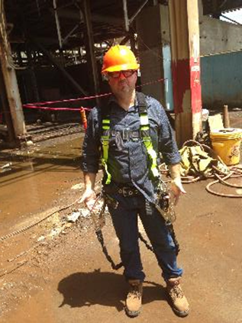
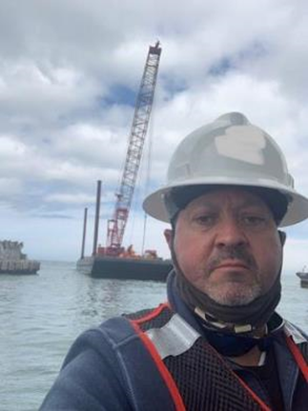
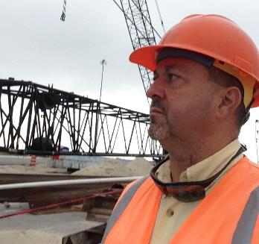
Phillip B. Russell
Handled 200 OSHA fatality cases; and hundreds of other types
Thought leader, speaker, author, and trainer OSHA legal issues
Editor, ABA’s Occupational Safety and Health Law treatise
College of Labor and Employment Lawyers
BTI Client Service All-Star
Chambers

Slide 3
Agenda
OSHA Basics
Recordkeeping Requirements
Dealing with an OSHA Inspection
OSHA’s Enforcement Priorities
2025 and Beyond

Slide 4
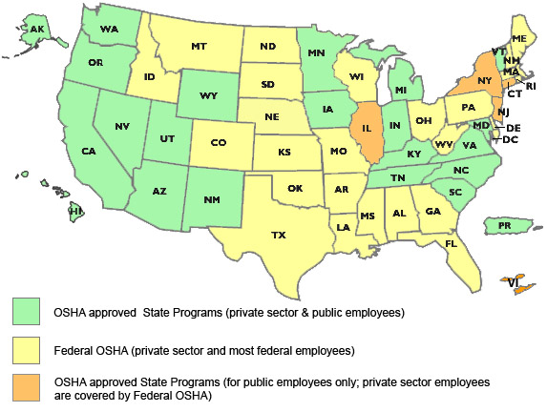
Federal OSHA and State Plans
https://www.osha.gov/stateplans/

Slide 5
Who is Covered
The Occupational Safety and Health Act of 1970 (OSH Act) is administered by the Occupational Safety and Health Administration (OSHA).
The OSH Act covers most private sector employers and their employees in the 50 states, the District of Columbia, Puerto Rico, and other U.S. territories.
Coverage is provided either directly by the Federal OSHA or by an OSHA-approved state job safety and health plan.

Slide 6
OSHA Regs
What they are and where they come from
Function
Investigation & Enforcement
Recognizing key regulations
Remembering the catch-all

Slide 7
Basic Provisions/Requirements
The Act assigns OSHA two regulatory functions: setting standards and conducting inspections to ensure that employers are providing safe and healthful workplaces.
Standards are grouped into four major categories: general industry (29 CFR 1910); construction (29 CFR 1926); maritime (shipyards, marine terminals, longshoring) (29 CFR 1915-19); and agriculture (29 CFR 1928).
The Act grants employees several important rights. Among them are the right to file a complaint with OSHA about safety and health conditions in their workplaces
Private sector employees who exercise their rights under OSHA can be protected against employer reprisal, as described in Section 11(c) of the OSH Act.

Slide 8
Key Standards
Paper” Rules
Recording/Reporting, Policies, Training, Discipline
Behavior Rules
Employee practices and behavior
Facility Rules
Machine Guards, Walking Surfaces
Equipment Rules
PPE, Fall Protection, Respiratory Protection
Machine/Vehicle Rules
LO/TO, Confined Spaces, Forklifts/PITs
Exposure Rules
MSDS, Contact/Inhalation, Temperature, Sound

Slide 9
General Duty Clause
Existence of a condition that is a recognized hazard.
Employer’s own knowledge
Condition is one that is causing or is likely to cause serious harm or death.
Must be serious
Industry or common knowledge
Feasible means of abatement exist.

Slide 10
Practical Tips
Identify serious hazards not covered by specific standard
Review incidents and near misses that could result in serious injury/illness
Stay up-to-date on OSHA initiatives, proposed rules, etc.
Stay up-to-date on industry practices (may need to look beyond your industry)
Pay attention to employee complaints

Slide 11
Practical Tips
Once you identify the hazard…
Do not ignore or easily dismiss the hazard as not feasible to abate
Review relevant manufacturer instructions
Review relevant industry standards
Review relevant OSHA standards and other agency standards

Slide 12
“Alternative Rulemaking”
Agency Guidance & the GDC
Memorandum
Enforcement Manuals
Advisory Opinions
Letters of Interpretation

Slide 13
Recording Requirements
Most employers with more than 10 employees at any time during the last calendar year are required to record serious work-related injuries and illnesses
OSHA 300, 300A and 301 forms

Slide 14
Federal OSHA Reporting Requirements
Report to OSHA within 8 hours:
Any work-related fatality
Report to OSHA within 24 hours:
Work-related in-patient hospitalization for care or treatment
Not if just for observation or diagnostic testing
Work-related amputation
Work-related loss of an eye
But not loss of sight without loss of eye

Slide 15
How to Report
Call your closest Area Office during normal business hours and speak to a person – don’t leave message
Call OSHA’s toll-free number: 1-800-321-OSHA (6742)
Report online
https://www.osha.gov/pls/ser/serform.html

Slide 16
Electronic Recordkeeping
In July 2023, OSHA released a final rule requiring certain large employers to electronically submit OSHA injury forms.
The rules became effective in January 2024 and requires establishments with 100 or more employees in certain designated industries to electronically submit OSHA 300 and 301 forms for each year.
Expect this to change under new administration and this requirement could be eliminated.

Slide 17
OSHA Inspections
OSHA inspections conducted by inspectors, called compliance safety and health officers
Normally, OSHA conducts inspections without advance notice
Compliance officer has right to enter worksite without unreasonable delay
Employers have the right to require compliance officers to obtain an inspection warrant before entering the worksite (we don’t recommend)
Opening Conference
Walkaround
Interviews
Document Requests
Closing Conference
Time: One Day to Six Months

Slide 18
OSHA Inspections
Imminent Danger
Fatality/Catastrophe
Complaints/Referrals
Programmed
Special Emphasis/Targeting Initiatives
Follow-up

Slide 19
The Walk-Around
OSHA’s first fact gathering
“Shadow” the compliance officer
Be polite and do not argue
Do not volunteer
Be aware of conversations with employees
No obligation to “stage”, start up or shut down operation
Consider how to handle apparent violations
“Plain sight” doctrine

Slide 20
New in 2024 -- OSHA’s Walkaround Rule
The representative(s) authorized by employees may be an employee of the employer or a third party. When the representative(s) authorized by employees is not an employee of the employer, they may accompany the Compliance Safety and Health Officer during the inspection if, in the judgment of the Compliance Safety and Health Officer, good cause has been shown why accompaniment by a third party is reasonably necessary to the conduct of an effective and thorough physical inspection of the workplace (including but not limited to because of their relevant knowledge, skills, or experience with hazards or conditions in the workplace or similar workplaces, or language or communication skills).

Slide 21
Key Provisions
Authorized Employee Representative (“AER”) may be:
An employee of the employer OR;
A 3rd Party.
3rd Party AER no longer limited by formal credentials (i.e.: industrial hygienist or safety engineer).
AER may be authorized based upon knowledge/skills/experience in:
Processes/hazards/conditions present at the workplace (or similar workplaces);
Language and communication skills;
To facilitate better communication between CSHO and employees.

Slide 22
Considerations When Designating AER
CSHO cannot designate AER, must be done by employees.
No vote required to designate AER.
No set number of employees required to designate AER.
No need for unanimous agreement, or even majority agreement.
Minimum → in worksites with more than >1 employee, then >1 employee needed to authorize AER.

Slide 23
CSHO’s Authority
CSHO has final say/ultimate authority in designation of 3rd party AER
1903.8(c): “…in the judgment of the Compliance Safety and Health Officer…”
CSHO has discretion to determine whether good cause has been shown as to why 3rd party AER is reasonably necessary to inspection.
If employer objects to AER designation → CSHO has authority to resolve all disputes.
CSHO can also limit/prevent AERs participation if AER’s conduct interferes with a fair and orderly inspection.
Just as with employer representative, CSHO can allow reasonable time for 3rd party AER to travel to worksite (usually 1 hour).

Slide 24
AER’s Role During Inspection
AER present to accompany CSHO and aid physical inspection of workplace in multiple ways:
Explaining equipment/processes/operations/policies/procedures;
Interpretation (during informal interviews);
Facilitate communication between CSHO and employees.
AER can also participate in opening and closing conferences.
May act as interpreter during informal interviews.
Not present for private interviews unless employee requests.
May ask clarifying questions to ensure understanding of a topic/issue.
Because CSHO already takes pictures and measurements, AER typically will not, unless given express permission by employer or entity controlling worksite.

Slide 25
AER’s Limitations During Inspection
AER may not disrupt or interfere with a fair and orderly inspection.
Examples of prohibited behavior include:
Preventing CSHO from taking essential photographs, video recordings, or testing;
Preventing CSHO from interviewing employees in private;
Interfering with employee or employer representative involvement in the inspection;
Failing to stay with CSHO during walkaround (i.e.: wandering, unauthorized areas);
Taking unauthorized photographs or videos;
Solicitation, such as handing out union authorization cards;
No limitation on AER wearing clothing promoting a union, however.
Distributing or handing out any material without the CSHO's review and consent;
Discussing matters unrelated to inspection with employees during inspection;
Failing to comply with the ground rules of the inspection.

Slide 26
Court Challenges
A coalition of business associations has filed a lawsuit against OSHA, captioned Chamber of Commerce of the United States of America, et al. v. OSHA, et al., arguing the Walkaround Rule exceeds the agency’s statutory authority.
Motions for summary judgment pending
A ruling for plaintiffs will drastically narrow or even strike down the rule
As of now, the rule is in effect

Slide 27
2025 Enforcement Priorities?
This may have all changed on November 5, 2024:
Heat Illness
Workplace Violence
Warehousing
Fall Protection
Process Safety Management
Emergency Response
Construction PPE

Slide 28
Heat Illness -- Scope and Application
Applies to all industries regulated by OSHA
General, construction, shipyard, marine terminals, long shoring, agriculture
Applies to all employers, except:
Organizations whose primary function is the performance of firefighting and certain emergency response activities
Does not apply to certain work activities:
No reasonable expectation of exposure at or above the initial heat trigger
Short duration employee exposures at or above the initial heat trigger of 15 minutes or less in any 60-minute period
Indoor work areas or vehicles where air-conditioning consistently keeps the ambient temperature below 80°F
Telework (employee chooses work location)
Sedentary work activities at indoor work areas

Slide 29
Initial Heat Trigger
New Proposed Heat Illness Rule – Trigger is Heat Index of 80°F! Consider taking action now. Ogletree has template programs that can help.
Drinking water
Readily accessible to employees
Suitably cool; and
Sufficient quantity to provide access to 1 quart of drinking water per employee per hour
Break areas at outdoor work sites
Readily accessible and can accommodate the number of employees on break
Shade (natural or artificial; but not from equipment) – that blocks direct sunlight and is open to outside air; OR
Air-conditioning in an enclosed space, such as a trailer, vehicle, or structure

Slide 30
Initial Heat Trigger Requirements (cont’d)
Break areas at indoor work sites
Readily accessible
Air-conditioned or has increased air movement (and maybe de-humidification)
Indoor work area controls
Increased air movement, such as fans or comparable natural ventilation and, if appropriate, de-humidification;
Air-conditioned work area; or
If radiant heat sources, other measures that effectively reduce employee exposure to radian heat in the work area (e.g., shielding / barriers, isolating heat sources)
Evaluation of fan use
At ambient temperatures above 102ºF, if the employer is providing fans for indoor work areas, the employer must also evaluate whether use is harmful (humidity)

Slide 31
High Heat Trigger Requirements (HI 90ºF)
These are in addition to the requirements for the initial heat trigger
Mandatory rest breaks
Employer must provide a minimum 15-minute paid rest break at least every two hours in the break area
A meal break may count as a rest break, even if it is not otherwise required by law to be paid
Donning and doffing periods do not count
Time for walking to and from the break areas does not count

Slide 32
High Heat Trigger Requirements (cont’d)
Mandatory observation methods
Mandatory buddy system in which co-workers observe each other; or
Observation by a supervisor or heat safety coordinator, with no more than 20 employees observed by each person
For employees alone at a work site, the employer must maintain effective two-way communications and make contact at least every two hours
Mandatory hazard alerts
Importance of drinking plenty of water
Employees’ right, at the employee’s election, to take rest breaks if needed and the mandatory rest breaks in this section
How to seek help and the procedures for an emergency
For mobile work sites, the location of break areas and drinking water
Excessively high heat indoor work areas
Warning signs required if ambient temperatures regularly exceed 120ºF

Slide 33
Heat Injury and Illness Prevention Plan (HIIPP)
Site-specific
Include a comprehensive list of the types of covered work activities
Identify the heat metric used (HI or WBGT)
Evaluation of vapor-impermeable clothing and alternatives
Written, if employer has more than 10 employees
Designate one or more heat safety coordinators
Implement and monitor the HIIPP
Authority to ensure compliance
Seek input and involvement of non-managerial employees and their representatives, if any, in the development and implementation of the HIIPP

Slide 34
HIIPP (cont’d)
Review and evaluate the HIIPP’s effectiveness after a heat-related incident, and at least annually
Readily available at the work site to all employees
Available in a language each employee, supervisor, and heat safety coordinator understands

Slide 35
Workplace Violence in Healthcare
Focused on patient violence toward healthcare workers
Behavioral Health
Long-term Care
Develop written workplace violence prevention program
Perform hazard assessments
Implement engineering and administrative controls
Train and educate staff
Maintain a workplace violence log

Slide 36
Process Safety Managament
Process safety management of highly hazardous chemicals
Recent directive and guidance issued by OSHA
This 103-page guidance, which is primarily a collection of hyperlinks to standard interpretations dating back to 1992, reiterates OSHA’s commitment to a national emphasis program (NEP) for inspecting facilities with HHC.

Slide 37
Emergency Response Rulemaking
On February 5, 2024, OSHA published the Notice of Proposed Rulemaking (NPRM) on Emergency Response
Would replace the existing Fire Brigade Standard
Would address a wider range of hazards and expand beyond firefighting services to include private employers who provide other emergency services (pre-hospital EMA)
Would incorporate 22 NFPA (National Fire Protection Association) standards by reference
Would enhance job performance and training requirements for fire service personnel

Slide 38
What to Expect in a Trump Administration
Unlikely to see an increase in OSHA’s budget and may even see it cut
Will result in fewer compliance officers and less enforcement action (inspections)
Focus on compliance assistance instead of inspections and penalties
Fewer press releases and public shaming of employers
Reduce the number of emphasis programs
Goodbye to the Walkaround Rule and Heat Stress and Workplace Violence Standards
Supreme Court’s Loper Bright decision will embolden deregulation efforts

Slide 39
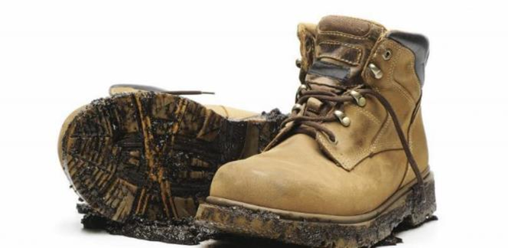
DIRTY STEEL-TOE BOOTS PODCAST
A podcast for safety professionals and in-house counsel responsible for workplace safety and health legal issues, including OSHA inspections, citations, litigation, and regulatory actions.
Ep. 1: Podcast Launch and 4 Starter Tips
Ep. 2: Who Is OSHA?
Ep. 3: Why Is OSHA Here?
Ep. 4: Corporate Safety Culture w/ VP of EHS, Mark Ligon
Ep. 5: A First Look at OSHA’s New ETS
Ep. 6: Florida’s New Law Restricting Employer Vaccine Mandates w/ Dee Anna Hays
Ep. 7: The SCOTUS Decision on OSHA’s ETS w/ Eric Hobbs
Ep. 8: Who is the DOL Solicitor? w/ Jaslyn Johnson
Ep 9: OSHA’s NEP on Heat Hazards w/ Karen Tynan

Slide 40
LINKEDIN POSTINGS ON OSHA TOPICS
Inspections
Citations
Informal settlement conferences
Contesting citations
Litigating citations
OSHRC
OSHA regulatory updates
Enforcement trends
Policy and people
linkedin.com/in/phillipbrussell

Slide 42
Thank you!
Phillip B. Russell
Ogletree Deakins Nash Smoak & Stewart PC
100 North Tampa Street, Suite 3600
Tampa, FL 33602
phillip.russell@ogletree.com
(813) 966-6598 (cell)

